Slide 1


Networking Concepts

Slide 2
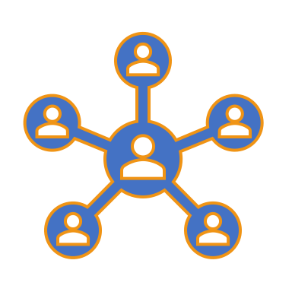
Vocabulary
Network Interface
The means by which data is transferred in/out of a computer system
Can exist as hardware or as software (With rise of virtual computing, hardware on virtual machine is simulated in software)

Slide 3
Vocabulary
Local Area Network (LAN)
A network or a portion of a network that is not publicly accessible to the greater internet. A home or office network is an example of a LAN.
Wide Area Network (WAN)
A network more extensive than a LAN. Usually meant to refer to the internet at large – something beyond your complete control.

Slide 4
Vocabulary
Packet
Most basic unit of information that is transferred over a network. Typically contains several additional pieces of information to ensure proper delivery.
When communicating over a network, packets are the envelopes that carry your data (in pieces) from one end point to the other.
Just as an envelope carries the message you are sending, the outside has the name, street address, city, and state of the recipient. Also has your return address (optional), a stamp and then the post office affixes a postmark over the stamp. All of this additional information is to ensure proper delivery.

Slide 5
Network Devices
Host
Any device on a network
Hub
Takes in packets, repeats on all ports
Switch
Takes in packets, reads MAC address of destination
Router
Takes in packets, reads IP address of destination
RIP: Routing Information Protocol (routers talking)

Slide 6
Vocabulary
Protocol
Set of rules and standards that define a language which devices can use to communicate. Large number of protocols in use in networking, often implemented for different purposes.

Slide 7
Vocabulary
Port
An address on a single machine that can be tied to a specific piece of software. Enables computer to be able to communicate using more than one application.
Not a physical interface or location.

Slide 8
Vocabulary
Network Address Translation (NAT)
A way to translate requests that are incoming into a routing server to the devices or servers it knows about on the LAN.
Devices outside the LAN only have the public-facing IP address of the NAT device (router), router then sends packets along to its intended destination once it receives the packet
Similar to a mail room at a large organization.
Letters come to mail room at a single mailing address
Mail room then sends letters to proper office in the building

Slide 9
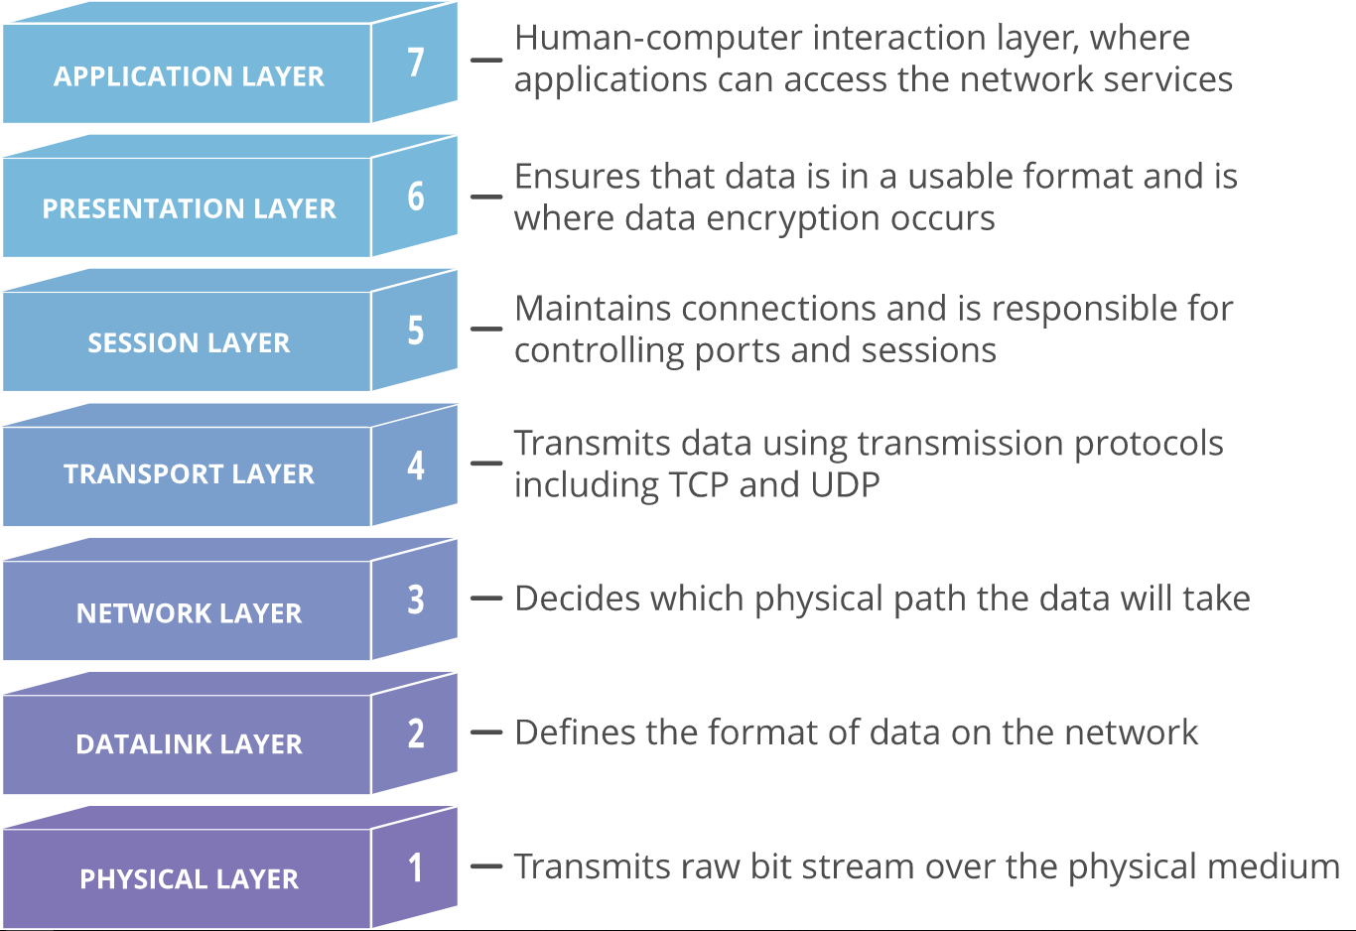
OSI Model
Layers separate the logical operations occurring in a communications exchange.

Slide 10
OSI Model
Application
Presentation
Conceptual framework
No network is pure OSI
Abstraction of all the steps in a reliable network From top to bottom and up again
Session
Transport
Network
Data Link
Physical

Slide 11
Application Layer
Application
Presentation
Links the user and the information
Provides meaning and visualization of data for human (or device) use
Session
Transport
Network
Data Link
Physical

Slide 12
Presentation Layer
Application
Presentation
Converts data from compressed, encrypted, encoded form into digestible "plain text" form
Session
Transport
Network
Data Link
Physical

Slide 13
Session Layer
Application
Presentation
Breaks data into "chunks" to be transmitted or received across several sessions.
Phone book through tube
Session
Transport
Network
Data Link
Physical

Slide 14
Transport Layer
Application
Presentation
Supports reliable communication over unreliable medium*
Synchronization, acknowledgement of sending/receiving
Session
Transport
Network
Data Link
Physical

Slide 15
Network Layer
Application
Presentation
Addressing, routing, path finding, collision detection/avoidance
Which path the data takes from here to there
Session
Transport
Network
Data Link
Physical

Slide 16
Data Link Layer
Application
Presentation
Makes sense of pulses, the 1s and 0s
Recombines the pulses into collections of data
Session
Transport
Network
Data Link
Physical

Slide 17
Physical Layer
Application
Presentation
Concerned with signal propagating from "here" to "there"
1 and 0 – however that may be expressed
Light, voltage, radio wave
Session
Transport
Network
Data Link
Physical

Slide 18
Application
Application
Presentation
Presentation
Session
Session
Transport
Transport
Network
Network
Data Link
Data Link
Physical
Physical

Slide 19

Addresses: Who am I?
Every network device has a unique fingerprint
MAC Address
128-bit number
6 Hexadecimal pairs, "octets" 00-FF
First 3 identify chip manufacturer (generally)
Last 3 unique to device
MAC is permanently "burned" in device, unchangeable (almost)

Slide 20
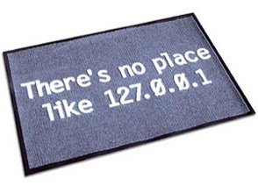
Addresses: Who am I?
IP Address
32-bit number (IPv4)
4 octets: 0.0.0.0 - 255.255.255.255
Static (assigned/fixed), Dynamic (changing)
Private IPs
Private:
10.x.x.x
192.168.x.x
172.16.x.x - 172.31.x.x
192.168.1.50
11000000 10101000 00000001 00110010

Slide 21
IPv4 vs IPv6
IPv6 gaining popularity due to scarcity of IPv4 addresses.
In 2015, the US ran out of IPv4 addresses. IPv6 allows for 340 undecillion possible addresses – That’s 1x10³⁶! Surely that will be enough, right?
Examples:
IPv4 address:
Need good example here
IPv6 equivalent:
Need good example here

Slide 22
Addresses: Who am I?
Windows | Open command line (Start, type "cmd") ipconfig /all
Mac / Linux | Open Terminal (Search in Spotlight if not found) ifconfig
iOS | Settings > General > About
Android | Settings Wireless & Networks or About Wi-Fi Settings or Hardware Info Menu > Advanced

Slide 23
DNS: Who are you?
DNS – Domain Name System
Servers provide "lookup" service
Originally referred to as YP
Authoritative, Mirrors
Names assigned by ICANN through Registrars
Domain Name | IP Address
google.com | 172.217.1.142
gmail.com | 172.217.14.165
amazon.com | 176.32.98.166
big-sale.cheap-discount.amazon.com.go.biz | 132.148.138.186
gmail-login.authenticated.gmail.com.hax.ru | 91.195.240.93

Slide 24
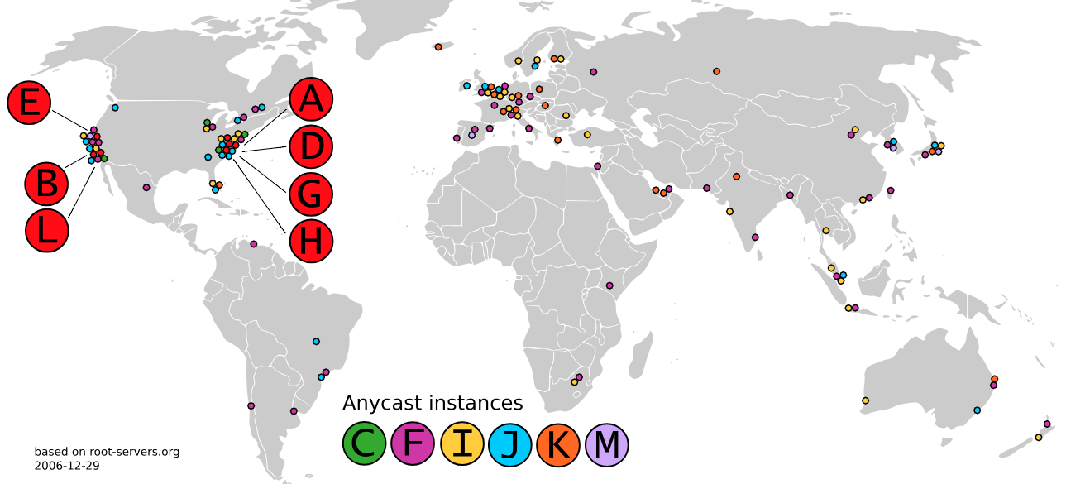
DNS: Root Name Servers

Slide 25
Major Protocols
TCP/IP
Transmission Control Protocol / Internet Protocol
Addressing
3-way handshake: SYN/SYNACK/ACK
HTTP/HTTPS
FTP
POP3/IMAP/SMTP
Telnet/SSH

Slide 26
Ports: What do you want?
Port | Service
21 | FTP | Transfer Files between systems
22/23 | Telnet/SSH | Remote command line access (SSH = encrypted)
80/88 | HTTP/HTTPS | Web server (HTTPS = encrypted)
110/143 | POP3/IMAP | Email retrieval
25 | SMTP | Email transmission
53 | DNS Server | Hostname information lookup

Slide 27
Tools: Where am I?
How far away is _____?
ping
What is the IP of _____?
nslookup
What is the path to _____?
traceroute/tracert
(Linux) (Windows)

Slide 28
Packets
Lots of information in plain-text in packet
Stored in specific order in a "header“
Network devices read headers to route information
Source |  |  | Destination
Sequence Number
Acknowledgement Number
Data Offset | Reserved | Code | Window
Checksum |  |  | Urgent
Options |  |  |  | Padding
Data

Slide 29
The Problem
The internet (any network) is unreliable
"The Two Generals“ Problem:
2 Generals, separated by a valley
Valley controlled by bad guys
Only successful if they attack together
How can they coordinate an attack and be sure of the proper time?
…unsolvable.

Slide 30
Algorithms make sense of it all
Who goes first? Who transmits when?
Exponential Backoff
Gets sending/receiving of hosts in sync
Wait 1 unit of time, wait 2 units, 4…, 8…, 16…

Slide 31
Algorithms make sense of it all
Additive Increase/Multiplicative Decrease (AIMD)
As soon as one packet is sent/received, 2 more are sent, then 3, 4, 5, 6, 7, 8…
As soon as one packet is lost, drop back by half

Slide 32

Reading List
Tubes by Andrew Blum
Layman’s look at the physicality of the internet
bit.ly/bookTubes

Slide 33

Reading List
Algorithms To Live By by Brian Christian and Tom Griffiths
Broader look at algorithms
bit.ly/bookAlgs

Slide 34

Reading List
9 Algorithms that Changed the Future by John MacCormick
Broader look at algorithms
bit.ly/book9Algs

Slide 35
Transmission Control Protocol
Implemented in transport layer of the TCP/IP model. Used to establish reliable connections.
Breaks data into packets.
TCP builds up a connection prior to data transfer using a system called a three-way handshake.
Allows two ends of the communication to acknowledge the request and agree upon a method of ensuring data reliability.
TCP is used for many of the most popular applications on the internet, including WWW, email, FTP, and SSH.

Slide 36
User Datagram Protocol
Companion protocol to TCP. Also implemented in the transport layer.
UDP offers unreliable data transfer. Does not verify that data has been received
Does not wait for confirmation, UDP is much faster than TCP.Sends off data to recipient and doesn't care if it is accepted or not.
Useful for simple, streaming communications like video, podcasts, video games, Voice over IP (VoIP) and querying network devices.

Slide 37
Hypertext Transfer Protocol
HTTP is a protocol defined in the application layer that forms the basis for communication on the web.
HTTP defines a number of functions that tell the remote system what you are requesting. For instance, GET, POST, and DELETE all interact with the requested data in a different way.

Slide 38
File Transfer Protocol
FTP is also in the application layer and provides a way of transferring complete files from one host to another.
Inherently insecure, not recommended except as a public, download-only resource.

Slide 39
SSH Protocol
Secure Shell
SSH is an encrypted protocol implemented in the application layer used to communicate with a remote server securely.
Many additional technologies are built around this protocol because of its end-to-end encryption and ubiquity.

